Slide 1
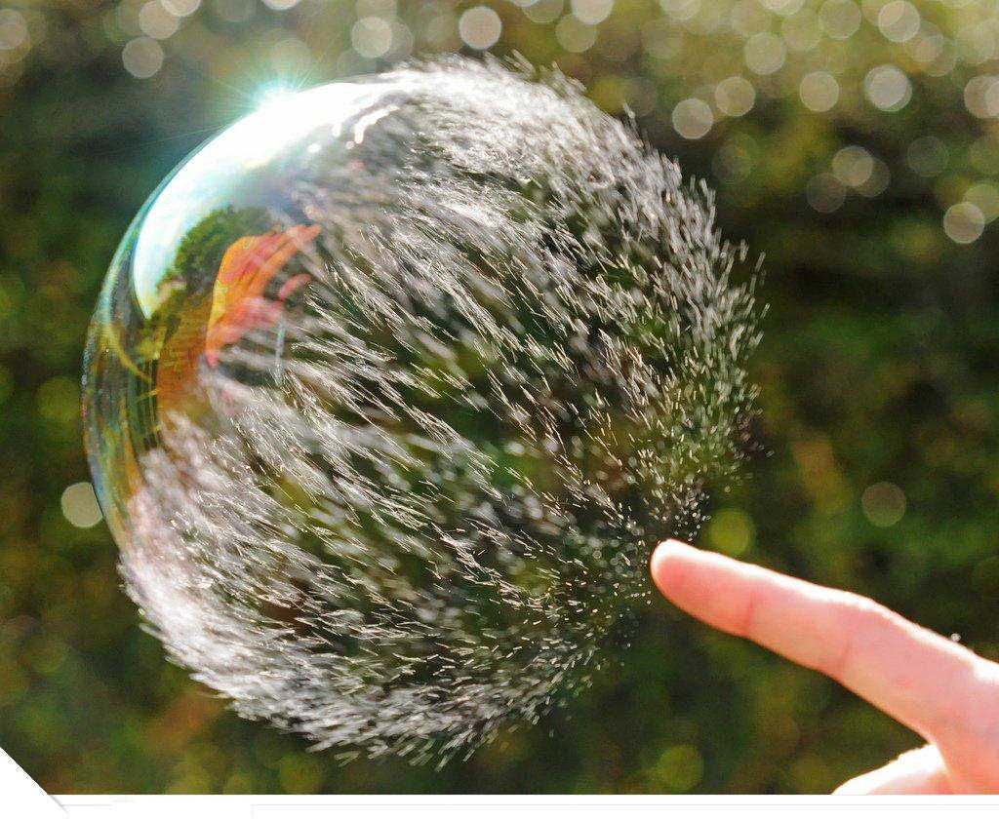
Introduction to Photography
“One should really use the camera as though tomorrow you'd be stricken blind.”
-Dorthea Lange

Slide 2
What is Photography?
the art, science, and practice of creating durable images by recording light or other electromagnetic radiation, either chemically by means of a light-sensitive material such as photographic film, or electronically by means of an image sensor.

Slide 3
Short history of Photography
Photography was invented in the beginning of the 19th century
Chemical photography was invented in the 1820s.
The first permanent photoetching (fundamental photography) was an image produced in 1822 by the French inventor Nicephore Niepce.
He made the first permanent photograph from nature (his View from the Window at Le Gras) with a camera in 1826.

Slide 4
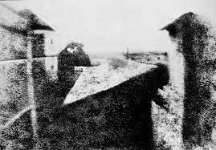

Slide 5
How a camera works…
Notice the inverted
(upside-down) tree.
When the shutter of a camera is opened, light passes through the lens
and onto the film. The film is covered with chemicals that create a
pattern of light on the film. This becomes the negative in chemical
Photography. Now, we often use digital/electronic photography.

Slide 6
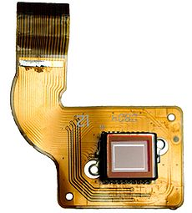
Image Sensor
An image sensor is a device that converts an optical image into an electronic signal.

Slide 7
There are three basic styles of photography.
Landscape
Portrait
Documentary

Slide 8
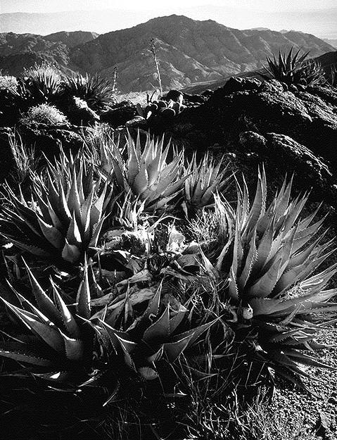
Landscape
Landscape is a photograph of the environment. It could be the forest, mountains, oceans, or your backyard. Ansel Adams is a famous landscape photographer. Here is one of his images.

Slide 9
Here is another of Ansel Adams Photographs

Slide 10
Portrait Photography
Portrait photography is a photo of a person or animal that shows an emotional connection.
What is the emotion shown in this photo?
Scared
Angry
Other…
Holding Virgina - Sally Mann

Slide 11
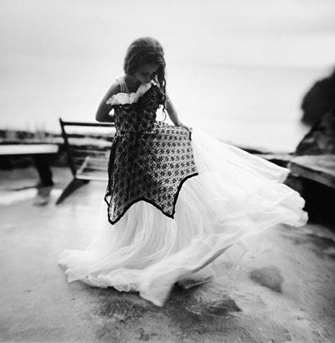
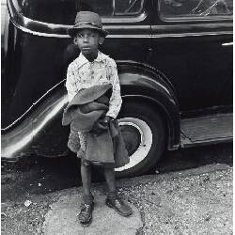
More Portraits
Portraits can be the whole body.
The Dress - Sally Mann
Boy and Car, New York City - Jerome Liebling, 1949

Slide 12
What are some ways you can make a portrait photograph creative and different from everyone else?

Slide 13
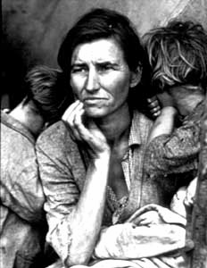
Documentary
Documentary photography presents a true scene without changing anything.
Good documentary photographs make you wonder what the story is behind the photograph.
Migrant Mother - Dorthea Lange

Slide 14
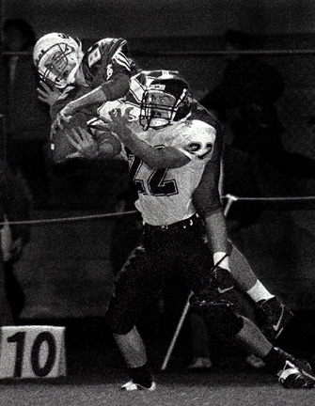
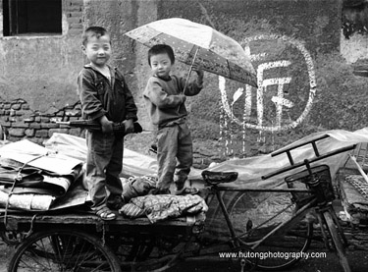
What are the stories in these photos?

Slide 15
Where do you find documentary photographs?
Magazines
Newspaper
Books
Internet

Slide 16
Contrast
Contrast refers to the brightness between the light and shadow areas of a picture.
Mapplethorpe, Orchid and Leaf in White Vase 1982

Slide 17
Does it have contrast? What direction is the light on the trees coming from?
Alfred Stieglitz - Icy Night, 1893

Slide 18
What is Contrast?
Contrast is the difference between light and shadow.
Think about a flashlight in a dark room.
LIGHTS
SHADOWS

Slide 19
The composition
The positioning of objects or the photos focus within the photograph

Slide 20
Rule of Thirds
A photo is more interesting if the subject is NOT directly in the center. Try placing your subject 1/3 to the left or right, or 1/3 from top or bottom.

Slide 21
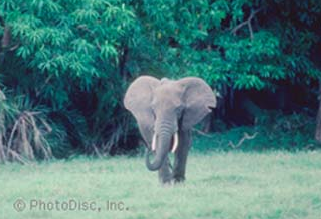
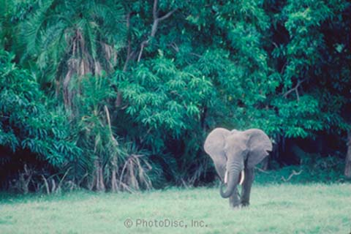
One photograph uses rule of thirds and the other uses central focus.
Central Focus
Rule of Thirds
Which photograph do you find more interesting?
WHY?

Slide 22
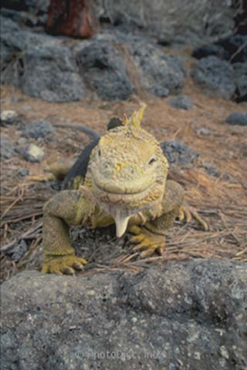
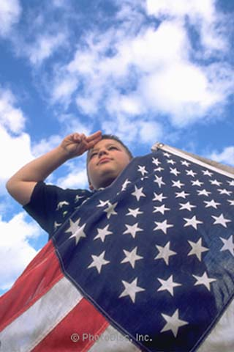
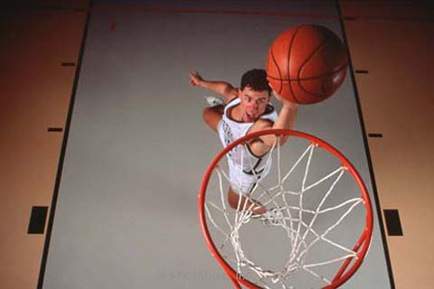
Point of View
Try selecting an unusual point of view.
Above
Eye Level
Below

Slide 23
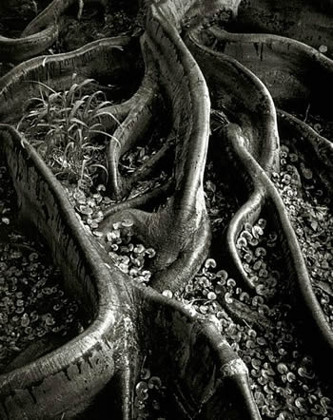
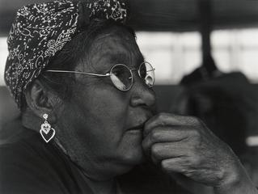
Proximity
Don’t be shy! Get close to your subject. But make sure you keep focus!

Slide 24
Basic Portfolio Project
Small groups, 1+ DSLR camera per group
Each person must take 4 photos of each of the three subjects: Landscape, Portrait, Documentary. (2 black and white, 2 color)
Each person must then write a short paragraph describing the photo, explaining the contrast (B&W), the point of view, composition and proximity of the picture as well as the subject.
As a group, you must decide on three themes, one theme for each of the subjects: Example, for Landscape the theme can be “Essentials for life”. What sort of landscape pictures would be included in this theme?

Slide 25
The group will take the photos and print them to bring into the class.
As a group, you must choose one best picture from each subject and print it as a 10x12. All other photos must be printed as a 5x7.
The group will present all photographs, each member explaining his own photographs and then as a group, explaining why they chose the three best photographs in relation to the photography vocabulary/tips.

Slide 26
Grading
10 points for each “best picture” as a group, 5 points for the photograph utilizing point of view, compositioning, and proximity (or contrast for B&W) and 5 points for the explanation (30 points as a group)
10 points for each “best picture” out of the four each student took individually, 5 points for the photograph utilizing best point of view, contrast/proximity and 5 points for the explanation (30 points individually)
10 points for printing out the photographs as described in the project
10 points for following the projects criteria
Total points: 80 (40 as a group, 40 individually)

